Slide 1
Graphics and Computational Programming
Alex Emeny

Slide 2
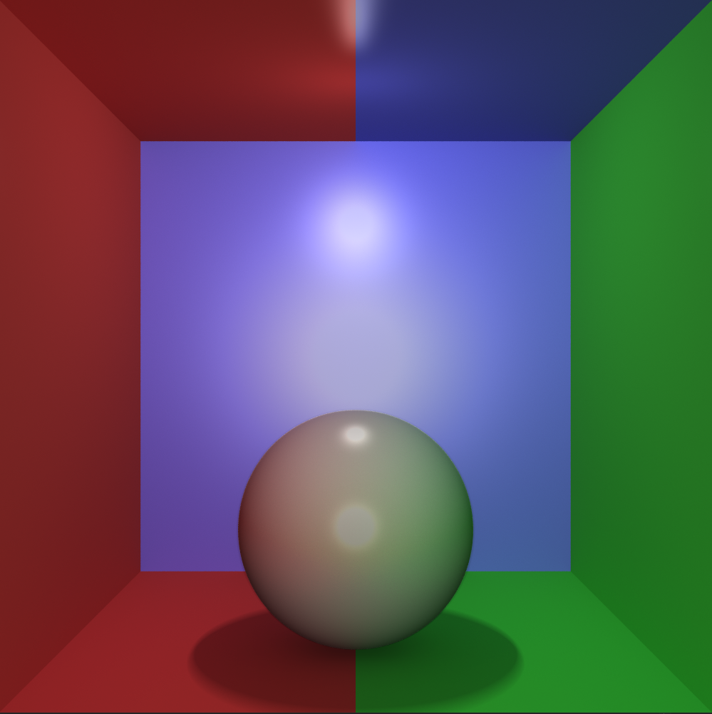
Presentation Overview
Theory
Design
Demo
Analysis
Evaluation

Slide 3
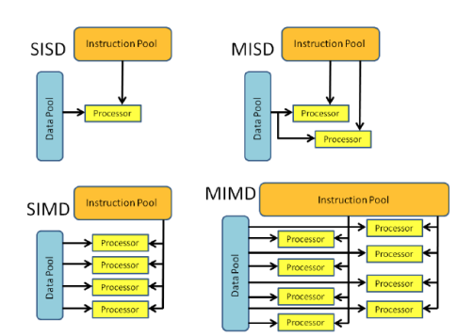
Theory – Parallel programming
A problem is broken into parts that can be solved concurrently.
Instructions from each part executed simultaneously on different cores.
In theory, more resources allocated to the problem the shorter the time to finish.
socials-20151110-rivi.pdf (ucl.ac.uk)

Slide 4
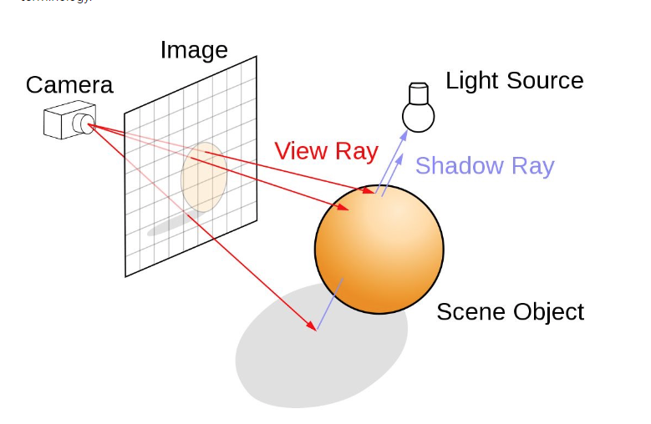
Theory – Ray tracing
Ray tracing is a rendering technique that is used to simulate realistic lighting in each scene by creating accurate reflections, refractions, shadows and indirect lighting.
Ray tracing generates a path from the view of a camera, through the 2D viewing plane into a 3D scene.
Can be inaccurate from the real world due to computational limits with modern day computers.
Ray Tracing | NVIDIA Developer

Slide 5
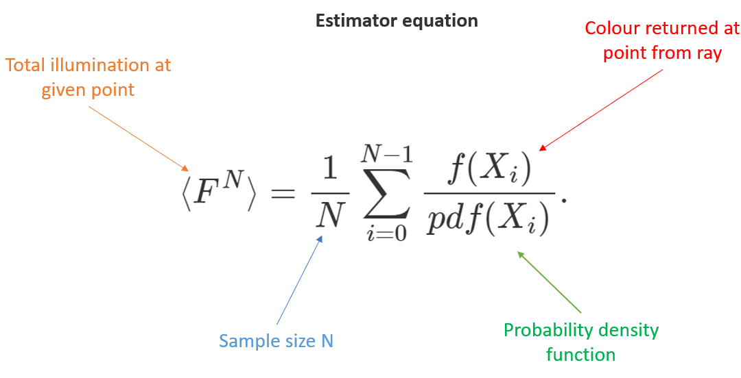
Theory – Monte Carlo Global Illumination
Monte Carlo method looks at the amount of colour that would fall onto a surface from indirect lighting.
The main problem with this technique is that the path tracing is slow and creates noisy images.
Monte Carlo theory states that to reduce noise level by two you would need four times the samples, which rapidly gets expensive to calculate for each ray.
Rays are fired in random directions from a hemisphere, and the average colour is accumulated from the samples taken.

Slide 6
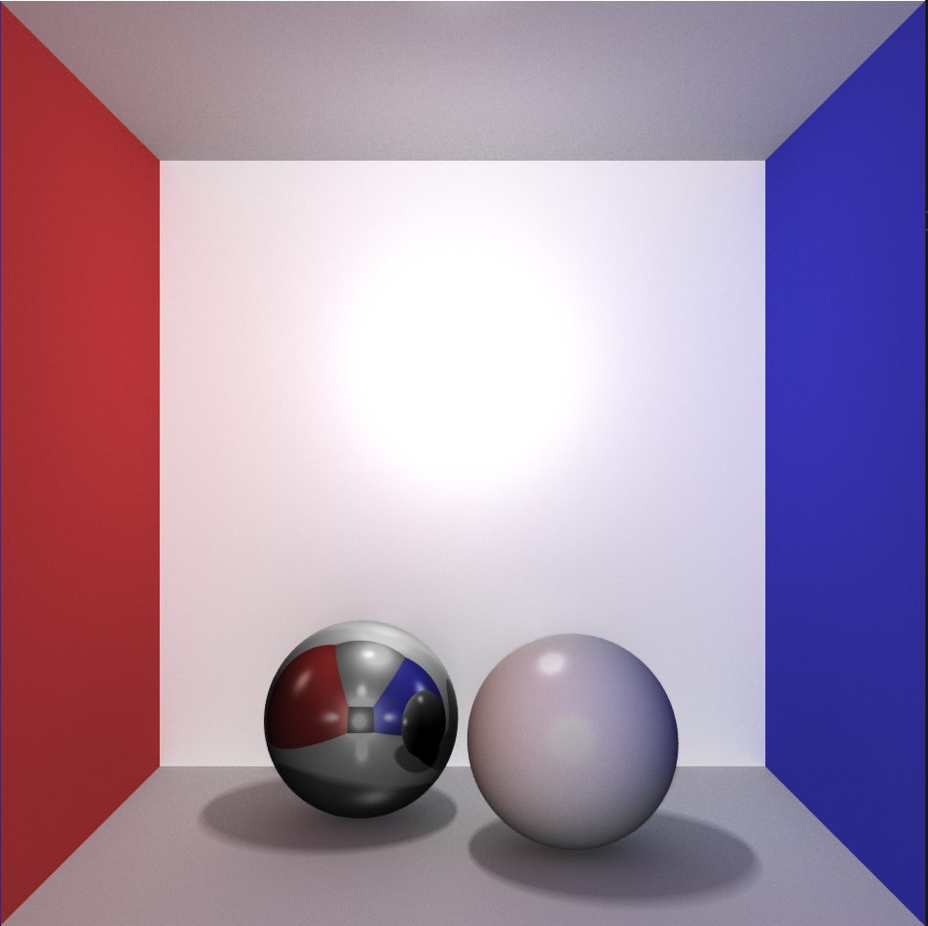
Design – My features
Multithreading / thread pooling
Multi-bounce reflections
Soft shadows
Global Illumination
Anti-aliasing
Multi-light sources

Slide 7
Design – Flow diagram
Start
AA Samples
Draw Pixel
Shadow Check
True
Bounces Left
> 0
False
True
Global Ill
> 0
False
Specular
Lighting
Shade
Calculation
Another Light
All lights
done
Each Light

Slide 8
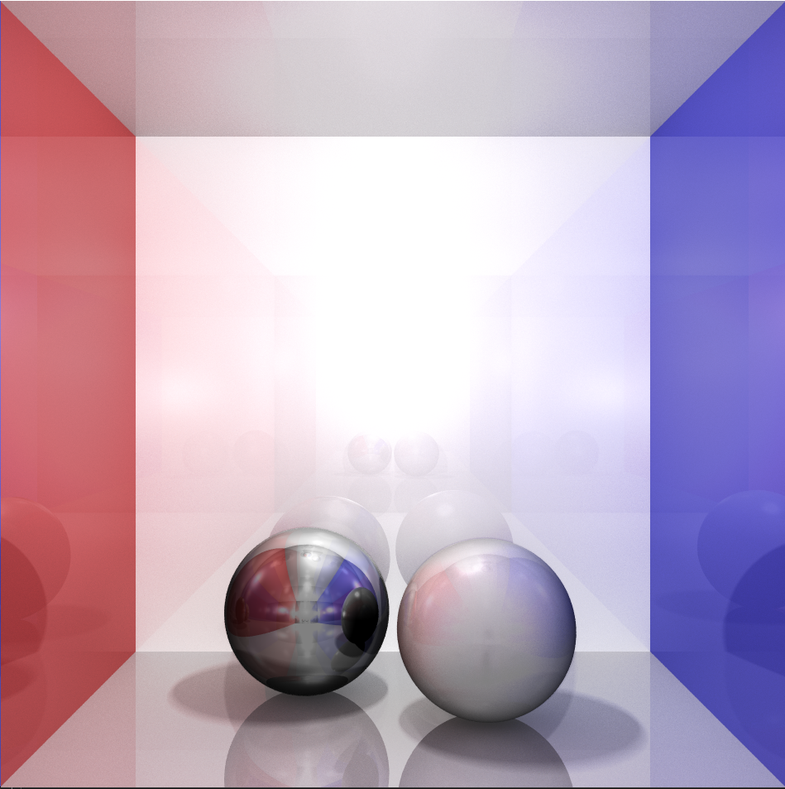
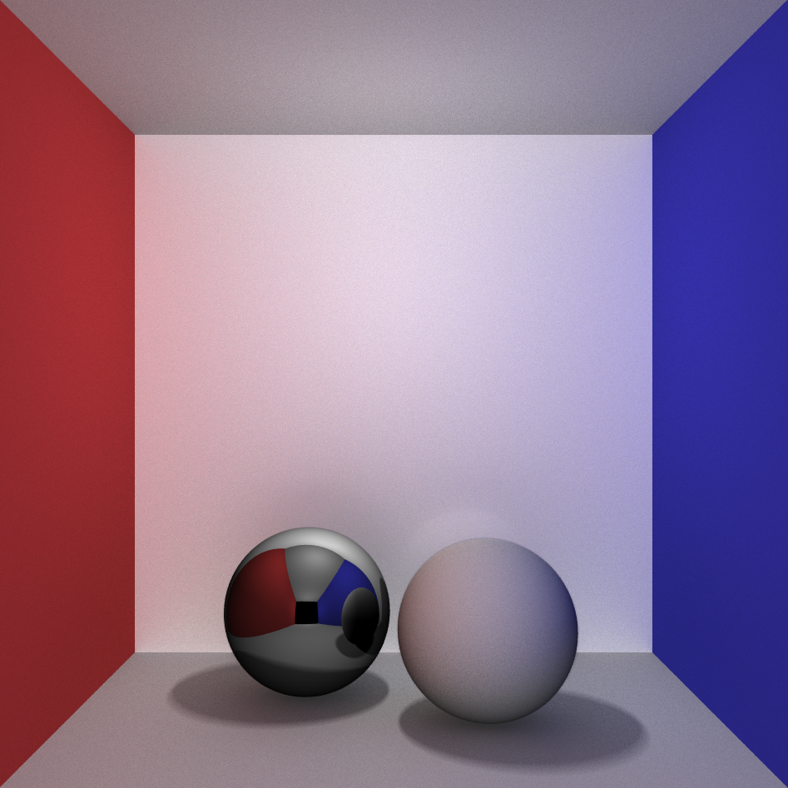
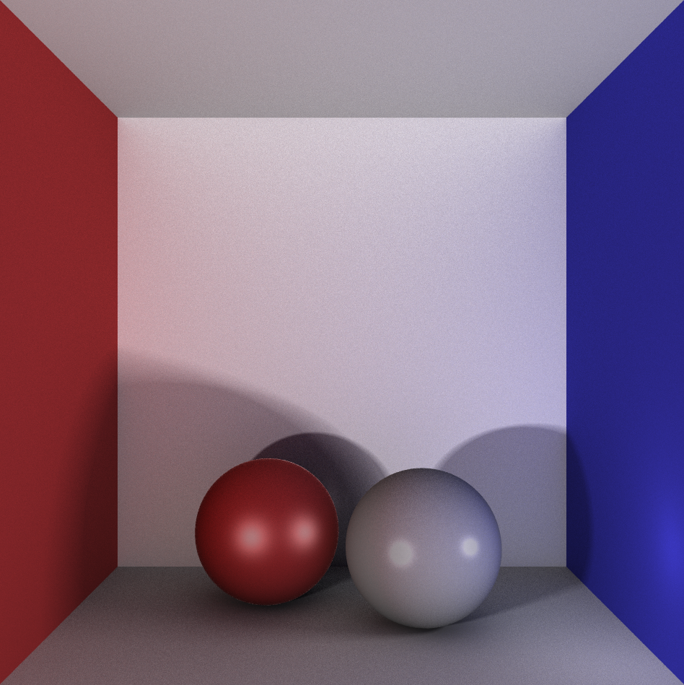
Demo

Slide 9
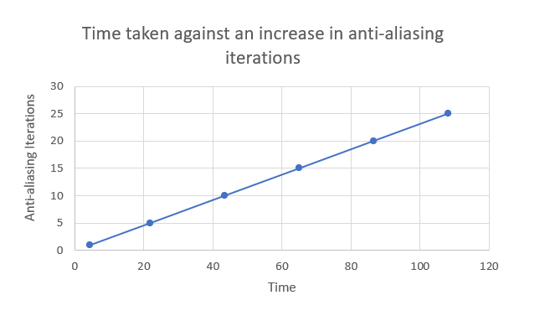
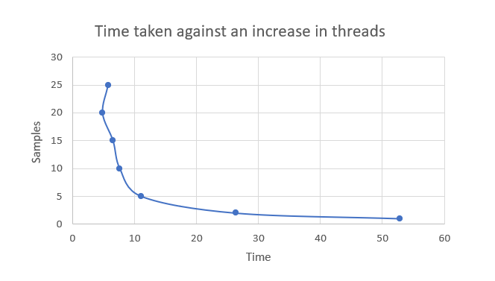
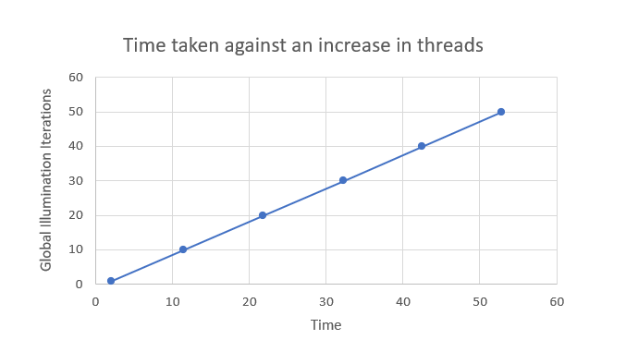
Analysis

Slide 11
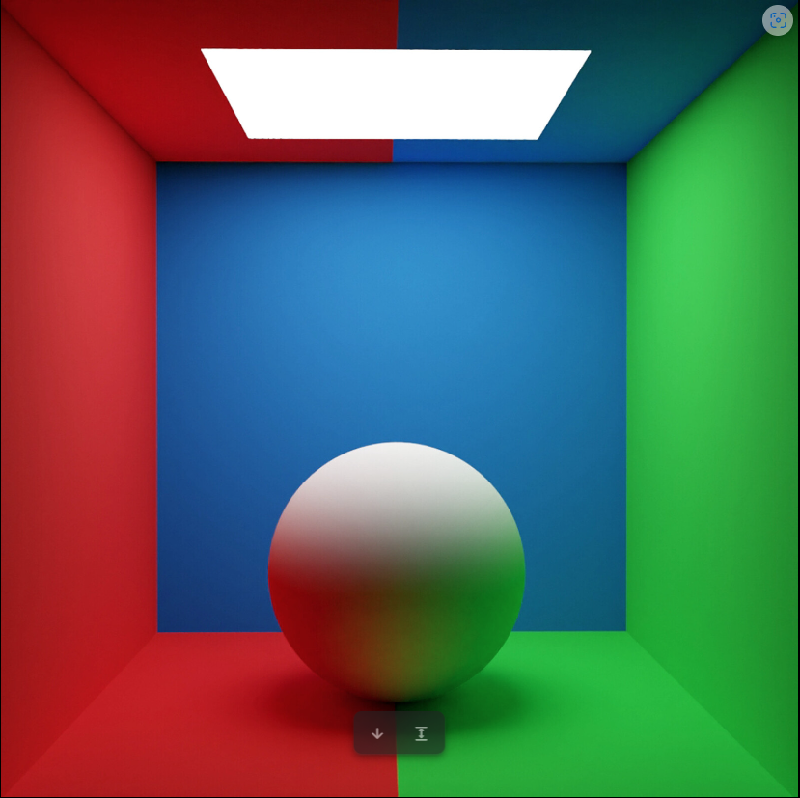
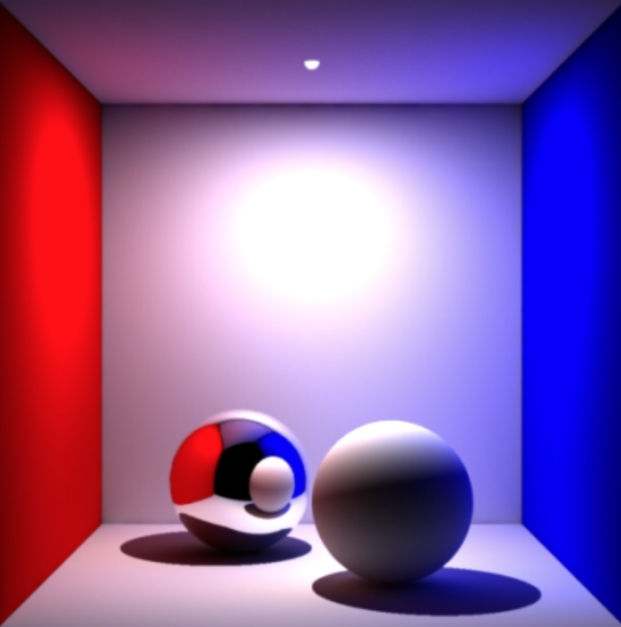
ArtStation - Cornell box render For Testing a Global Illumination
My reference renders
Global Illumination and All That (seanet.com)
My render
My render

